Slide 1
Impact of IR4.0 on Education
By
Norhayati Ahmad

Slide 2
This presentation…
Why is it happening?
Heutagogy
Curriculum: Characteristics and Implementation
Conclusion

Slide 3
Why is it happening?
IR4.0
New Education Vission : Malaysia Education Blueprint 2015 - 2025 (Higher Education)
The changing facets of Current and Future Generations of Students

Slide 4
Which Generation are You?
(*age if still alive today)
Generation Name | Births Start | Births End | Youngest Age Today* | Oldest Age Today*
The Lost Generation The Generation of 1914 | 1890 | 1915 | 103 | 128
The Interbellum Generation | 1901 | 1913 | 105 | 117
The Greatest Generation | 1910 | 1924 | 94 | 108
The Silent Generation | 1925 | 1945 | 73 | 93
Baby Boomer Generation | 1946 | 1964 | 54 | 72
Generation X (Baby Bust) | 1965 | 1979 | 39 | 53
Xennials | 1975 | 1985 | 33 | 43
Millennials Generation Y, Gen Next | 1980 | 1994 | 24 | 38
iGen / Gen Z | 1995 | 2012 | 6 | 23
Gen Alpha | 2013 | 2025 | 1 | 5

Slide 5
iGen/Gen Z
Less "in person" and "face to face" contact with others due to more time connecting via gadjets
Heavy use of gaming
Less reading of books, and newspapers
Grew up more supervised, more protected than prior generations
Less experience with teen jobs and earning money in high school
Experience with disruptive technology (smartphone, UBER, airbnb)
May stay up till 2 AM using smart phone and social media
Possibly more depressed than prior generations
Feels more lonely, and not needed
Possibly a higher suicide rate

Slide 6
Heutagogy
Personalization of learning
Co-Curators of Knowledge
Blurring in Academic Disciplines

Slide 7
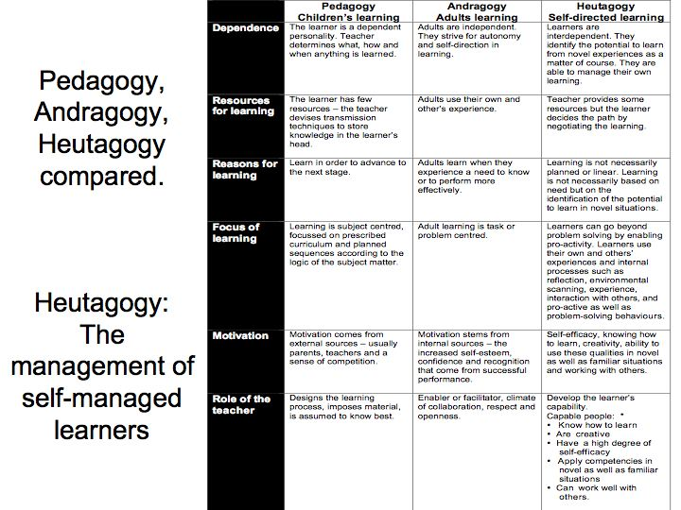

Slide 8
Curriculum incorporates…
Life skills, talent and other value added skills
Human centred rather than tasks based
Interdisciplinary
Convergence of man and machine (technology enhanced, gamification)
Development of affective domains (social intelligence as much as IQ)
Anywhere, anytime learning

Slide 9
Teaching and Learning process
Active learning (student centred learning)
Self directed learning (explore and learn, learning by doing, home schooling?)
Peer learning (group activities, co-operative learning))
Challenge based learning (competitions, designs)
Synchronised classroom (interactive, you-tube, life streaming with other universities)
Open on-line courses (anywhere, anytime)
Achievement of skills (digital badge, certificates, credentials, progress bar)
2U2i (learning at univ and industries)

Slide 10
Characteristics of Fluid and Organic Curriculum
1.Risk Tolerant & allows inter-disciplinary study
2.Personalised –recognizes individual interest, ability and style
3.Responsive, non-prescriptive and flexible -what, when and where to study
4.Focus on humanistic elements & permits maximum self-actualization of each individual
5.Develops specific and measurable cognitive & behavioural attainments
6.Involves co-curation & trust
7.Excites, challenges, and motivates each student
8.Feedback through assessment for learning and assessment as Learning
9.Transparent and Intentional
10.Rewards every key achievement
11.Leverages on Technology to enrich & enhance learning
12.Promotes self-directed, independent learning
* Ref (Taylor’s University: Developing Fluid and Organic Curriculum)

Slide 11
Some implementations in Malaysian Universities
CEO@faculty
- local and international CEO of industries to share experience and knowledge
2U2i
- 2 years in universities and 2 years in industries
MOOCs (Massive Open Online Courses)
- Online learning that can transfer credit to formal academic programme
Gap Year
- 2 sem off to do: national services, volunteerism, general (sports, travels and work)
Jukebox Education
- Campus-in-Campus (CIC) initiative
- Engaging students in global clasroom (student exchange, Joint Degree, Joint supervision, joint research and laboratory with partner universities
APEL
- Accreditation of Prior Experiencial Learning
- identification, documentation and evaluation of previous experienced based learning
- from certificate to Master degree

Slide 12
Example
Go to Taylor’s presentation slides
Go to Taylor’s website

Slide 13
COMPLEMENTARY STUDIES
The Complementary Study Component allows student to study modules in a related or unrelated field from the same or different school to complement the primary major. It may be completed in a form of free electives, extension, minor or a second major that typically requires at least one (1) semester of student learning time.

Slide 14
Broad electives
Electives – Choose from five to seven free elective modules in 3 different clusters of which not related to the Primary Major. These clusters include (i) Arts, Humanities and Social Sciences, (ii) Business, Services and Management and (iii) Science, Technology and Society.
A Minor – Gain breadth of knowledge by taking five set modules outside of a particular major field of study. There are 53 minors offered.
An Extension – Expand depth of knowledge by taking five set modules in a specific area within a major field of study. There are 21 extensions available.
A Second Major – Master another field of study by taking 12 set modules. Choose from 11 majors.

Slide 15
Conclusion
Education providers need to be sensitive to customer requirement as students have plenty of choices…
MEDIU/Faculty…..
Need to benchmark other universities
(local and international)
Need to venture into new areas/fields
Need to conduct market survey
Need to review curriculum to suit current trends (main content, new electives and technology support)
Need to upgrade facilities for effective T&L
Need to train lecturers on heutagogy

